Slide 1

Tata Motors: Can the turnaround plan improve performance
Case Study 3
GEE - 1MEIC03 - G24
Ana Rita Oliveira - up202004155
André Soares - up202004161
Diogo Fonte - up202004175
Milena Gouveia - up202008862
Luís Cabral - up202006464

Slide 2
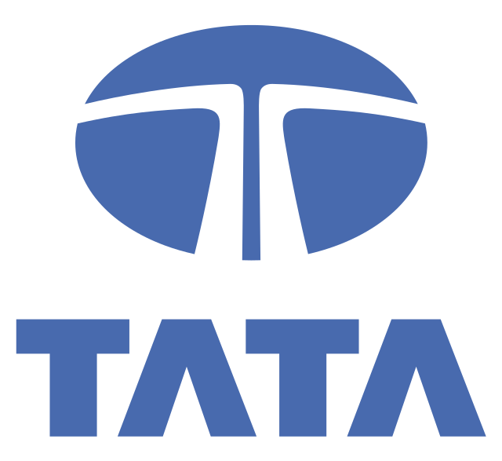
01
Key Challenges Confronting Tata Motors
Notes:
Question 1: By looking at the company’s financial performance and market position, identify the main issues that Tata Motors was facing.

Slide 3
Financial Performance
Revenue Decline (FY 2017)
First negative growth in ten years
Consecutive Quarterly Losses
First three quarters of FY 2019
Third quarter marked the biggest quarterly loss ever
Share price reduced by over 60% since 2018
Cost Structures (FY 2017)
Cost structures “out of whack”
Loss of money in passenger cars
Lax Governance Standards
Aggressive accounting practices
NPAs increased ₹40+ billion
Improper risk assessment methods
Strained Cash Flows (FY 2019)
Significant amount of debt
compared to its equity
Notes:
Financial Performance
Consecutive Quarterly Losses: The aggregate loss over the first three quarters of FY 2019, with the Q3 being the biggest quarterly loss ever. This resulted in a reduction in Tata Motors’ share price by over 60% since 2018.
Lax Governance Standards: The group suffered from lax governance standards, including using aggressive accounting practices to substantially capitalize the product development costs, using improper risk assessment methodologies that had led to an increase in non-performing assets of more than ₹40 billion, and that the board had continued the operations of an unsustainable Nano (entry-level car) project.
Revenue Decline: In FY 2017, the company's revenue had a negative growth for the first time in ten years. While it somewhat recovered in FY 2018, the situation remained concerning.
Cost Structures: In 2017, the chairman of the parent company of Tata Motors claimed that “in passenger cars, our cost structures are out of whack. Every single car and model is losing money.”
Strained Cash Flows: In FY 2019, Tata Motors made an “ambitious capital expenditure plan of ₹461 billion”, which “further strained the reducing cash flows and led to a high leverage position”, meaning that they had a significant amount of debt compared to its equity.

Slide 4
Market Position
Underutilized Installed Capacity
Transition to modular platforms
Underused capacity
High fixed costs
Transition to new emission standards (Bharat Stage VI)
Aggressive Competition
Pressure on companies to maintain profitability
Notable rise in production (FY 2018)
Loss of market share to Maruti Suzuki
Notes:
Market Position
Transition to new emission standards (Bharat Stage VI): The announcement made by the Indian government generated pressure on automobile players to maintain profitability.
Aggressive competition that was observed in the automobile industry market that led them to increase their production by more than 90% in fiscal year 2018 compared to fiscal year 2017 (60 vs 31). This competition brought with it other losses for Tata Motors such as the loss of its market share to Maruti Suzuki India Limited, which held 50% of the market share.
Underutilized Installed Capacity: a transition from conventional platforms to new modular platforms whose main goal was to gain economies of scale, ended up generating underutilized install capacity and high fixed costs

Slide 5
02
Risks and Opportunities for Companies like Tata Motors
Notes:
Question 2: Based on the automobile industry reality of that time, what risks and opportunities do you identify for companies as Tata Motors?

Slide 6
Risks
Liquidity Crunch in the Economy and Drop in Availability of Retail Finance
Financial health of consumers and businesses affected.
Reduced availability of funds for large purchases.
Harder to obtain loans, that leads to less sales.
Consumer Preferences and Competition
Preference for more eco-friendly and/or technologically advanced vehicles.
Rise of taxi aggregators like Uber and Ola.
Slow Down in GDP
Reduced consumer spending power.
Automobiles are significant purchases.
Car sales affected.
Regulation Changes
Carbon emissions and environmental impact.
Need for alternative fuels.
Notes:
Risks:
Regulations Change:
Risk: New rules and regulations related to carbon emissions and environmental impact can increase production and development costs, as automobile manufacturers need to redesign vehicles to create hybrid and electric models.
Mitigation: Tata Motors can invest in ongoing research and development to stay ahead of regulatory changes, focus on developing scalable and adaptable vehicle platforms that can easily be modified, and seek partnerships or alliances with technology companies specializing in green technologies to share the burden of development costs and accelerate innovation.
Slowdown in Gross Domestic Product (GDP):
Impact: A slowdown in GDP growth can lead to reduced consumer spending power, directly affecting car sales as automobiles are significant purchases often postponed during economic uncertainty.
Mitigation: Tata Motors can focus on exporting to countries with stronger economic growth or diversify into more stable sectors like commercial vehicles, which may be less impacted by GDP fluctuations.
Bad Monsoon:
Impact: In India, agriculture significantly depends on the monsoon season. A bad monsoon can lead to poor agricultural output, reducing rural incomes and affecting demand for vehicles in rural areas, which is a substantial market for Tata Motors.
Mitigation: The company can introduce affordable financing options or launch new models tailored for the rural market to maintain sales volumes.
Low Industrial Production:
Impact: A decline in industrial production indicates a broader economic slowdown, which can reduce the demand for commercial vehicles and fleet sales.
Mitigation: The company can diversify its product line to include more fuel-efficient or multi-purpose vehicles that appeal to industries looking to cut costs.
Liquidity Crunch in the Economy and Drop in Availability of Retail Finance:
Risk: A liquidity crunch and a drop in the availability of retail finance can collectively impact Tata Motors' sales. Economic instability may affect the overall financial health of consumers and businesses, reducing the availability of funds for large purchases like vehicles. Additionally, if consumers find it harder to obtain loans for car purchases, it can lead to a decrease in sales.
Mitigation: Tata Motors can maintain a robust balance sheet and liquidity reserves to weather financial uncertainties and ensure they can continue operations and sales efforts. Moreover, the company can collaborate with financial institutions to create special financing schemes or offer in-house financing solutions to make purchasing easier for consumers, thereby mitigating the impact of reduced availability of retail finance.
Changing Consumer Preferences and Competition from Taxi Aggregators:
Risk: Shifts in consumer preferences towards more eco-friendly, technologically advanced vehicles, and the rise of taxi aggregators like Uber and Ola present significant challenges. These trends can reduce the demand for private vehicle ownership and impact sales if Tata Motors does not keep pace with these evolving preferences.
Mitigation: Tata Motors can invest in market research to understand evolving consumer preferences and innovate their product lineup accordingly. Additionally, the company can develop partnerships with ride-sharing companies to supply vehicles, explore the production of models specifically designed for ride-sharing purposes, and invest in technology to enhance the connectivity and user experience of their vehicles to compete effectively in the evolving transportation landscape.

Slide 7
oPPORTUNITIES
Environmental and Regulatory Compliance and Increase in Electric Vehicle Production
Demand for compliant vehicles.
New market segments and reduced competition from
non-compliant manufacturers.
Development of New Technology
Invest in innovative technologies, such as:
Advanced safety features
Autonomous driving capabilities
Connectivity solutions
Research Emission Standards
Develop vehicles ahead of regulatory requirements.
Gain competitive advantage.
Possibly influence policy.
Global Expansion
Expand into new international markets.
Increase market reach and revenue streams.
Notes:
Opportunities:
Government Plan:
Opportunity: The Government of India and SIAM's “Automotive Mission Plan 2016–26” envisions India becoming one of the top three automotive manufacturing hubs globally, with the industry expected to generate approximately US$300 billion by FY 2026.
Strategy: Tata Motors can leverage this supportive policy framework by increasing investment in local manufacturing capabilities, focusing on innovation and quality to compete on a global scale, and collaborating with government initiatives to benefit from subsidies, incentives, and infrastructure development.
Global Expansion:
Opportunity: Entering new international markets can increase market reach and revenue streams.
Strategy: Conduct market research to identify potential markets, establish international sales and distribution networks, and tailor products to local preferences and regulatory requirements.
Research Emission Standards:
Opportunity: By leading in emission standards research, Tata Motors can develop vehicles that are ahead of regulatory requirements, gaining a competitive edge and possibly influencing policy.
Strategy: Invest in R&D to create cleaner, more efficient engines and vehicles, potentially securing government incentives or subsidies for meeting and exceeding standards.
Environmental and Regulatory Compliance and Increase Electric Vehicles (EV) Production:
Opportunity: Stricter environmental regulations and the growing demand for electric vehicles present significant market opportunities. Compliance with environmental regulations can drive demand for compliant vehicles, opening up new market segments and reducing competition from non-compliant manufacturers. Simultaneously, the increasing demand for EVs represents a significant market opportunity as consumers and governments push for greener transportation options.
Strategy: Tata Motors can focus on producing vehicles that meet or exceed environmental regulations, enhancing brand reputation and attracting environmentally conscious consumers. Additionally, the company can accelerate the development and production of EVs, secure partnerships for battery technology, and expand the charging infrastructure to make EV ownership more convenient for consumers. By aligning with both environmental compliance and the EV market trend, Tata Motors can capitalize on the growing demand for eco-friendly vehicles and strengthen its position in the automotive industry.
Development of New Technology:
Opportunity: Investing in technology can lead to innovations that set Tata Motors apart, such as advanced safety features, autonomous driving capabilities and connectivity solutions.
Strategy: Partner with tech companies and invest in cutting-edge technology to stay at the forefront of automotive innovation and appeal to tech-savvy consumers.

Slide 8
03
General Trends in Tata Motors Financial Performance
Notes:
Question 3: By looking to the financial statements for the past five years and analysing their structure and evolution, evaluate the general trends in Tata Motors’ financial performance.

Slide 9
Exhibit 7
Revenue
Expenses
Net Income
Steady growth in their revenue and gross profit also reflected this. Biggest growth between 2013 and 2014. Peak in 2018
Increase of nearly 400k in their expenses. Fine as long as they grow enough so that the net at the end increases.
Steady growth from 2013 to 2015 with a peak of 180k in 2015.
Following years, we can see a negative trend in the income.
Fiscal year ended March 31 (in ₹ million except per share data) | 2013 | 2014 | 2015 | 2016 | 2017 | 2018
Revenue | 1,887,927 | 2,328,337 | 2,631,590 | 2,776,606 | 2,744,921 | 2,954,093
Total Operating Expense (including Cost of Revenue) | 1,719,675 | 2,116,730 | 2,374,542 | 2,568,430 | 2,576,429 | 2,828,108
Net Income | 98,924 | 139,909 | 180,299 | 115,791 | 74.544 | 89.887
Notes:
From Exhibit 7:
Revenue: They had a steady growth in their revenue (except between 2016 and 2017 but the difference is very minimal) and their gross profit also reflected this. Between 2013 and 2014 they saw their biggest growth in revenue and it peaked in 2018
Expenses: Initially in the years 2013 and 2014 they had an increase of nearly 400k in their expenses, which is fine as long as they grow enough so that the net at the end increases.
Net income: In 2014 their net income grew more than 40k. In the following year (2015), they achieved their best results by growing another 40k and reaching a net income of 180k. In 2016, they had a net income lower than 2014, caused by the increase in expenses, despite growth in revenue. This negative trend continued into 2017 as their net reached the lowest in this time interval. Despite the slight raise in 2018, the net income was still lower than in 2013.

Slide 10
Exhibit 8
Operating Activities
Investing Activities
Cash from operating activities showed an overall steady increase up until 2016, but from 2017 onward, there is a clear decline. Some of the causes for this decrease could be negative accounts receivable, decline of net income, negative changes in working capital, etc.
Significant capital expenditures have been a consistent trend, with outflows increasing from ₹188,626 million in 2013 to ₹350,789 million in 2018. This reflects ongoing investments in fixed assets and intangibles, potentially for growth and modernization.
Fiscal year ended March 31 (in ₹ millions) | 2013 | 2014 | 2015 | 2016 | 2017 | 2018
Cash from Operating Activities | 221,626 | 361,917 | 355,317 | 378,995 | 301,993 | 236,135
Cash from Investing Activities | (234,194) | (298,930) | (348,672) | (375,044) | (380,799) | (262,016)
Capital Expenditures | (188,626) | (269,751) | (319,622) | (315,030) | (304,669) | (350,789)
Notes:
From Exhibit 8:
Operating Activities: Cash from operating activities showed an overall steady increase up until 2016, but from 2017 onward, there is a clear decline. Some of the causes for this decrease could be: negative accounts receivable, decline of net income, negative changes in working capital, etc.
Investing Activities: Significant capital expenditures have been a consistent trend, with outflows increasing from ₹188,626 million in 2013 to ₹350,789 million in 2018. This reflects ongoing investments in fixed assets and intangibles, potentially for growth and modernization.

Slide 11
Exhibit 9
Assets
Liabilities
Equity
Total assets have grown, with significant increases in cash and short-term investments. However, accounts receivable and inventories also increased, suggesting higher sales, but also higher dues and stock.
Liabilities have also grown, with short and long-term debt having a significant increase.
The equity shows some fluctuations between years, increasing up until 2014 and in the subsequent years alternating between increase and decrease.
Fiscal year ended March 31 (in ₹ millions) | 2012 | 2013 | 2014 | 2015 | 2016 | 2017 | 2018
Total Assets | 1,449,312 | 1,703,782 | 2,199,983 | 2,381,437 | 2,671,412 | 2,737,544 | 3,313,505
Total Liabilities | 1,122,327 | 1,327,409 | 1,543,949 | 1,828,711 | 1,881,887 | 2,156,925 | 2,359,226
Total Equity | 326,985 | 376,373 | 656,035 | 552,726 | 789,524 | 580,619 | 954,279
Notes:
From Exhibit 9:
Assets: Total assets have grown, reaching ₹3,313,505 million in 2018, with significant increases in cash and short-term investments. However, accounts receivable and inventories also increased, suggesting higher sales but also higher outstanding dues and stock.
Liabilities: Liabilities have also grown, with short-term and long-term debt having a significant increase, particularly by 2018.
Equity: The equity of Tata Motors shows some fluctuation between years, overall increasing from 2013 to 2016, with a decrease in 2017 and a significant increase in 2018. Since the equity is calculated from the assets and liabilities, the fluctuating equity reflects the fluctuations in these two fields.

Slide 12
04
Economic and Financial Evolution of Tata Motors
Notes:
Question 4: By performing a profitability, efficiency, liquidity and financial analyses, assess the economic and financial evolution of Tata Motors and its ability to generate profits and pay its liabilities. Explain the changes in the different ratios observed.

Slide 13
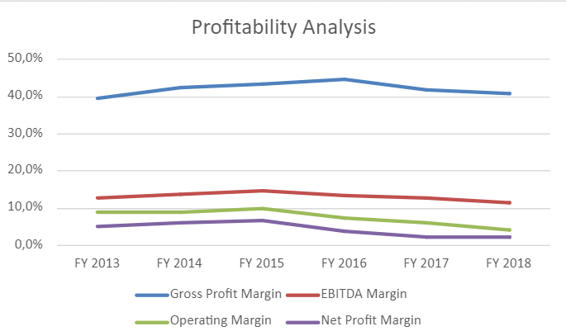
Profitability analysis
Gross Profit Margin
Operating Margin
39.7% to 41,0%
8.9% to 4.3%
EBITDA Margin
Net Profit Margin
12.9% to 11.6%
5.2% to 2.3%
Notes:
Profitability Analysis:
Gross Profit Margin: Increased from 39.7% to 41% (2013 to 2018) which means that they had a better cost management
Net Profit Margin:Decreased from 5.2% to 3% which means that their expenses were higher and as such despite an increase in their gross margin, the net went down
Operating Margin: Heavily decreased from 8.9% to 4.3% which indicates a decrease profit when taking into account the operating expenses
EBITDA Margin: Decreased from 12.9% to 11.6%, showing a decrease in the company’s profitability (before non-operating expenses).

Slide 14
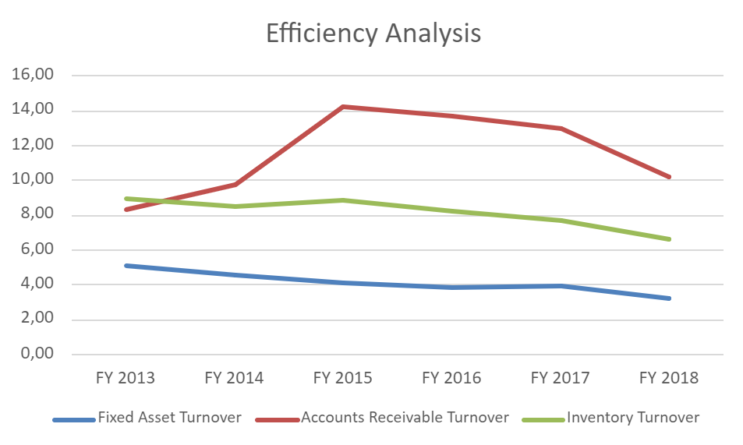
Efficiency analysis
Fixed Asset Turnover
Inventory Turnover
5.09 to 3.28
9.0 to 6.7
Accounts Receivable Turnover
8.3 to 10.2
Notes:
Efficiency Analysis:
Fixed Asset Turnover: Decreased from 5.09% to 3.28% which meant that they are generating less revenue per dollar invested in fixed assets.
Inventory Turnover Ratio: Went from 9% to 6.7% which shows that the inventory was managed in a less efficient and poorer way.
Accounts Receivable Turnover: Went from 8.3% to 10.2% which means that they were more efficient in collecting their outstanding receivables

Slide 15
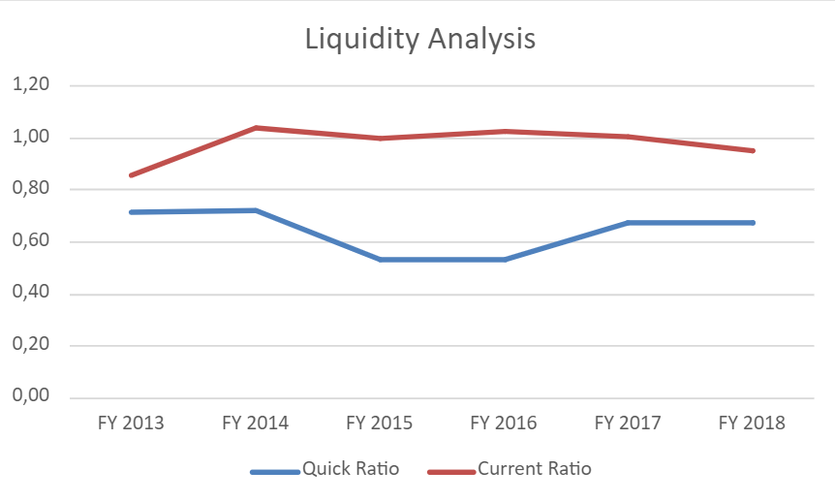
Liquidity analysis
Quick Ratio
0.72 to 0.68
Current Ratio
0.86 to 0.95
Notes:
Liquidity Analysis:
Quick Ratio: Decreased from 0.72 % to 0.68% which means that there are liquidity issues
Current Ratio: Increased from 0.86% to 0.95% and this improvement means that their ability to cover their liabilities with their assets was better

Slide 16
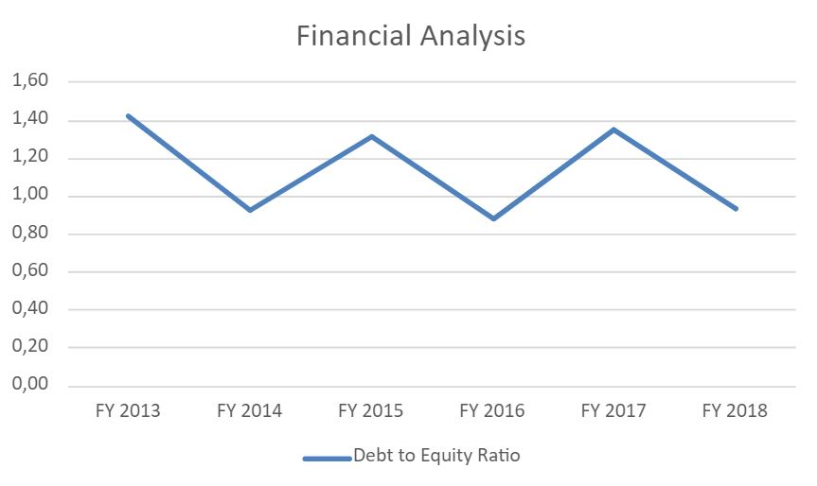
Financial analysis
Debt to Equity Ratio
1.43 to 0.93
Notes:
Financial Analysis:
Debt to Equity Ratio: Decreased from 3.53% to 2.35% showing that they had less financial leverage and more solvency (Relied less on borrowed money and had a better ability to meet their long term financial goals)

Slide 17
05
Strategies to improve Tata Motors’ financial position
Notes:
Question 5: Based on your financial and business analysis of Tata Motors, what strategies do you recommend to improve the company’s financial position?

Slide 18
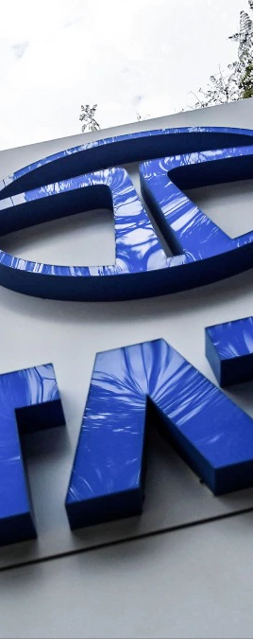
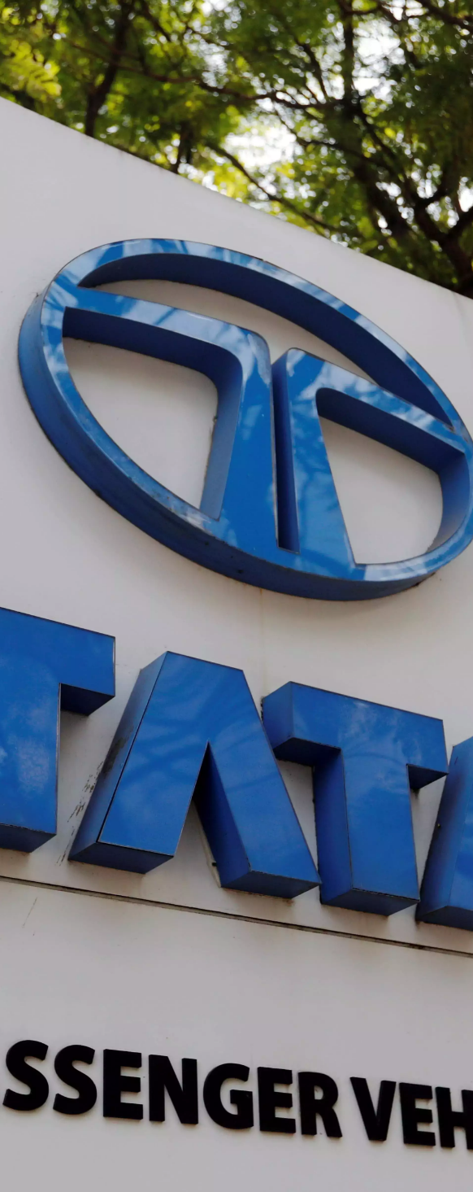
Strategies
Increase Profit Margins
Increase efficiency
Use innovative strategies to lower the cost of expenses.
Find new ways of generating income to compensate for increased costs
Invest in technologies that optimize asset utilization
Invest in systems that can find better ways to manage the inventory
Boost Liquidity
Strategic Partnerships
Focus more on increasing cash reserves
Find financing options to cover short term needs
Tech companies involved in creating innovative solutions, and companies that provide accessibility needs.
Notes:
Possible Strategies:
Cost Management and Revenue Generation:
One of the issues were the profit margins, as such to increase them they could:
Use strategies to control and possibly lower the cost of their expenses.
Use strategies to find new ways of generating income to compensate for their costs. This approach is effective when expenses remain relatively stable.
Efficiency:
Another need is to increase efficiency, and to do this they could:
Invest in technology that can determine the best possible ways to utilize their assets.
Implement new and improved systems to perform better inventory management, including trying to reduce waste of product.
Boosting Liquidity
Boosting liquidity is essential for financial stability. Strategies include:
Build up cash reserves to ensure readiness for short-term needs.
Explore financing options to address immediate liquidity needs. This can provide temporary relief while long-term liquidity solutions are established.
Strategic Partnerships
To get a better competing product for evolving customer passengers, that could lead to more sales, they could:
Get partnerships with tech companies involved in creating innovative solutions for electric vehicles, autonomous driving, safety features.
Get partnerships with companies that provide solutions for accessibility needs to try to expand the target market.

Slide 19
THAnk YOU!

